Slide 1

Object Oriented Analysis and Design using Java
UE19CS353
Prof. Mahitha G and Prof. Sindhu R Pai
Department of Computer Science and Engineering

Slide 2

UE19CS353: Object Oriented Analysis and Design using Java
State Modelling – Part 2
Prof. Mahitha G and Prof. Sindhu R Pai
Department of Computer Science and Engineering

Slide 3
Object Oriented Analysis and Design using Java
Agenda
Activity Effect
Do-Activites
Entry and Exit Activities
Completion Transition
Sample state diagram with Activities

Slide 4
Object Oriented Analysis and Design using Java
Activity Effect
Effect is a reference to a bahavior that is executed in response to an event and activity is the actual behavior that can be invoked by any number of effects
References to the behavior of the object with state change or the activity (an action of an activity) that is invoked in response to an event
Activities can also represent internal control operations – setting attributes or generate other events
Example:
DisconnectPhoneLine might be an activity that is executed in response to an onHook event.
Program might increment an internal counter every time a particular event occurs

Slide 5
Object Oriented Analysis and Design using Java
Activity Effect contd..
An activity may be performed upon
  a transition
  the entry to or exit from a state, or
  some other event within a state.
Notation is “/” and name of the activity following the event causes it.
do – Reserved for indicating the ongoing activity and may not be used as an event name
Event
Activity
Cursor moved/highlight menu item
r_button_down / showPopup
Idle
Menu visible
r_button_up / hidePopup

Slide 6
Object Oriented Analysis and Design using Java
Usage of Activity effect
Often useful to specify an activity that is performed within a given state
Examples:
  While in PaperJam state, the warning light should be flashing
  On entry into the Opening state, the motor should be switched on
  Upon exit of the Opening state, the motor should be switched off

Slide 7
Object Oriented Analysis and Design using Java
Do - Activities
An activity that continues for an extended time.
Can only occur within a state and cannot be attached to transition
Includes
  Continuous operations, such as displaying a picture on a television screen
  Sequential operations that terminate by themselves after an interval of time
“do /” denotes a do-activity that is performed for all or part of duration that an object is in a state
May be interrupted by an event received during execution; may or may not cause state transition
PaperJam
do/ flash warning light

Slide 8
Object Oriented Analysis and Design using Java
Entry and Exit Activities
Can bind activities to entry to/ exit from a state
All transitions into a state perform the same activity, in which case it is more concise to attach the activity to the state
Example:
The control of a garage door opener
The user generates depress events with a pushbutton to open and close the door.
Each event reverses the direction of the door.
The control generates motor up and motor down activities for the motor.

Slide 9
Object Oriented Analysis and Design using Java
Diagram - 1
Opening
Depress / motor up
Door open/ motor off
Depress
/ motor up
Closed
Open
door closed / motor off
Depress/motor down
Closing
Figure: Activities on transitions. An activity may be bound to an event that causes a transition

Slide 10
Object Oriented Analysis and Design using Java
Diagram - 2
Opening
entry/motor up
Door open
depress
Closed
entry/motor off
Depress
Open
entry/motor off
door closed
Depress
Closing
entry/motor down
Figure: An activity may be bound to an event that occurs within a state

Slide 11
Object Oriented Analysis and Design using Java
Order of activities
activities on incoming transition
entry activities
do-activities
exit activities
activities on outgoing transition
Note: Events that cause transitions out of the state can interrupt do-activities. If a do-activity is interrupted, the exit activity is still performed

Slide 12
Object Oriented Analysis and Design using Java
Completion transition
Unlabelled transitions triggered by the completion of activity in the source state
An arrow without event name indicates automatic transition that fires when the activity associated with the source state is completed.

Slide 13
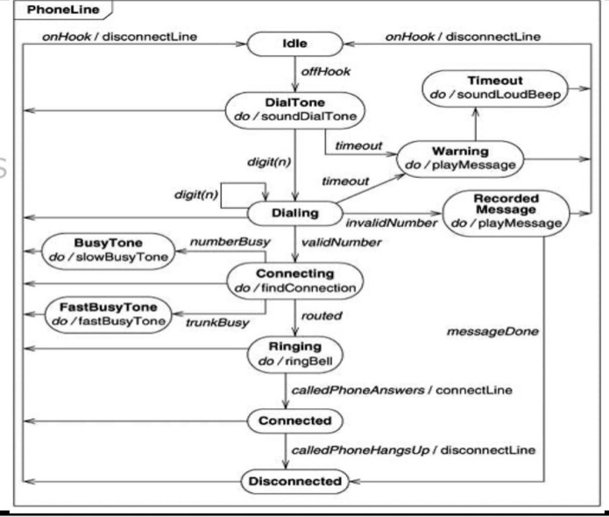
Object Oriented Analysis and Design using Java
Sample state diagram with Activities

Slide 14
References
Text Book: Object Oriented Modeling and Design with UML, by Michael R Blaha and James Rumbaugh.

Slide 15
THANK YOU
Prof. Mahitha G and Prof. Sindhu R Pai
Department of Computer Science and Engineering
mahithag@pes.edu
sindhurpai@pes.edu
+918277606459

